Slide 1
Chapter 3 Project Management

Slide 2
Lesson Objectives
Explain the principal tasks of software project management
Evaluate the importance of project management
Discuss the key issues of team working – team composition, cohesiveness & communication

Slide 3
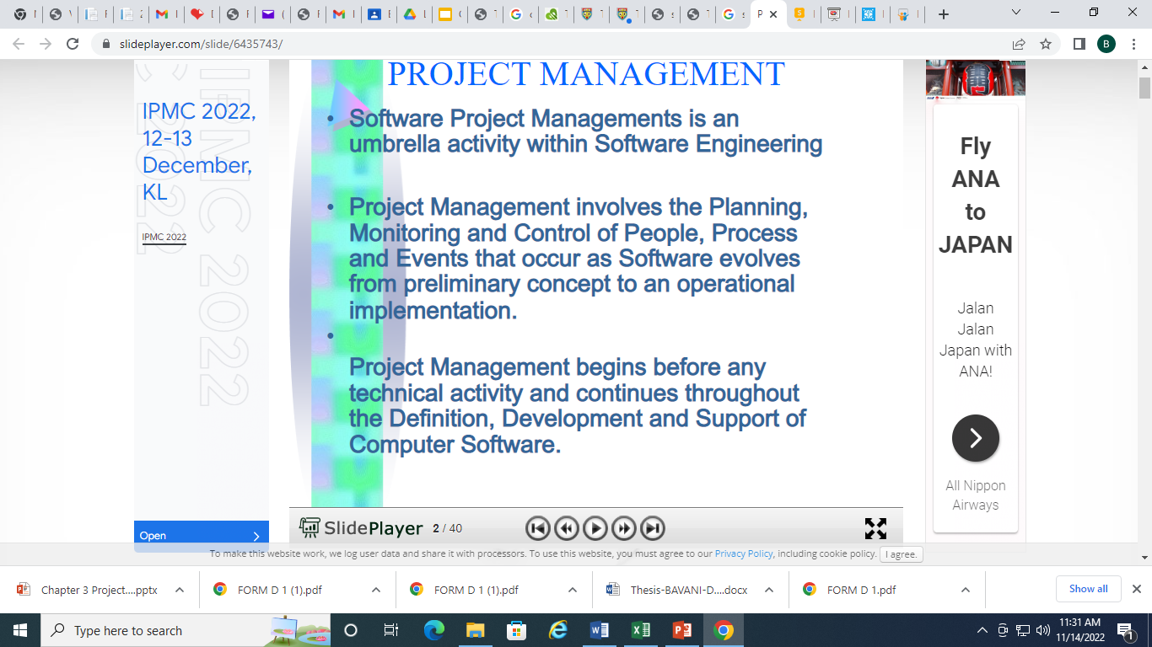

Slide 4
TASKS OF SOFTWARE PROJECT MANAGEMENT

Slide 5


What are the main responsibilities of an IT project manager?
Supervise
Planning
Software Manager
Monitor progress
Scheduling

Slide 6
What are the main responsibilities of an IT project manager?
Software managers are responsible for planning and scheduling project development.
They supervise the work to ensure that it is carried out to the required standards.
They monitor progress to check that the development is on time and within budget.

Slide 7
Management Activities
Proposal writing
Project planning and scheduling
Project costing
Project monitoring and reviews
Personnel selection and evaluation
Report writing and presentation

Slide 8

1. PROPOSAL WRITING

Slide 9
1. Proposal Writing
Objectives
Cost
How to carry out
Schedule

Slide 10
1. Proposal Writing
Proposal – describes the objectives of the project and how it will be carried out.
It usually includes cost and schedule estimations

Slide 11

2. PROJECT PLANNING

Slide 12
2. Project Planning
Activities
Project Plan
Milestones
Deliverables
Preliminary Investigation Report, Requirement Specification,
Design Specification, Prototype etc.

Slide 13
2. Project Planning
Project planning is concerned with identifying the activities, milestones and deliverables
Preliminary Investigation Report, Requirement specification, Design specification, Prototype etc.
A project plan will be drawn up to guide the development towards the goals

Slide 14

2. Project Planning
Total Work
Separate Activity
Time Required
Project Scheduling

Slide 15
2. Project Planning
Work Breakdown
Chart
Activity Dependencies
Staff Allocations
Project Scheduling

Slide 16
2. Project Planning
Gantt Chart
Chart
PERT Chart
Project Scheduling

Slide 17
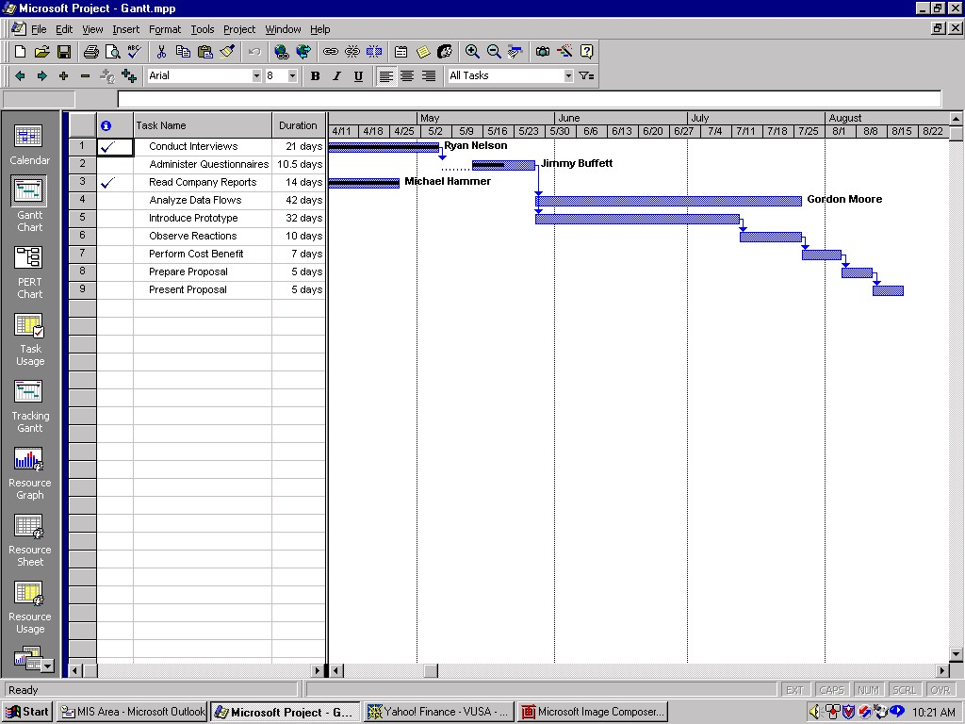
2. Project Planning – Gantt Chart

Slide 18
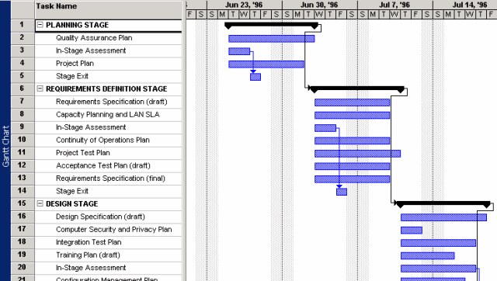
2. Project Planning – Gantt Chart

Slide 19
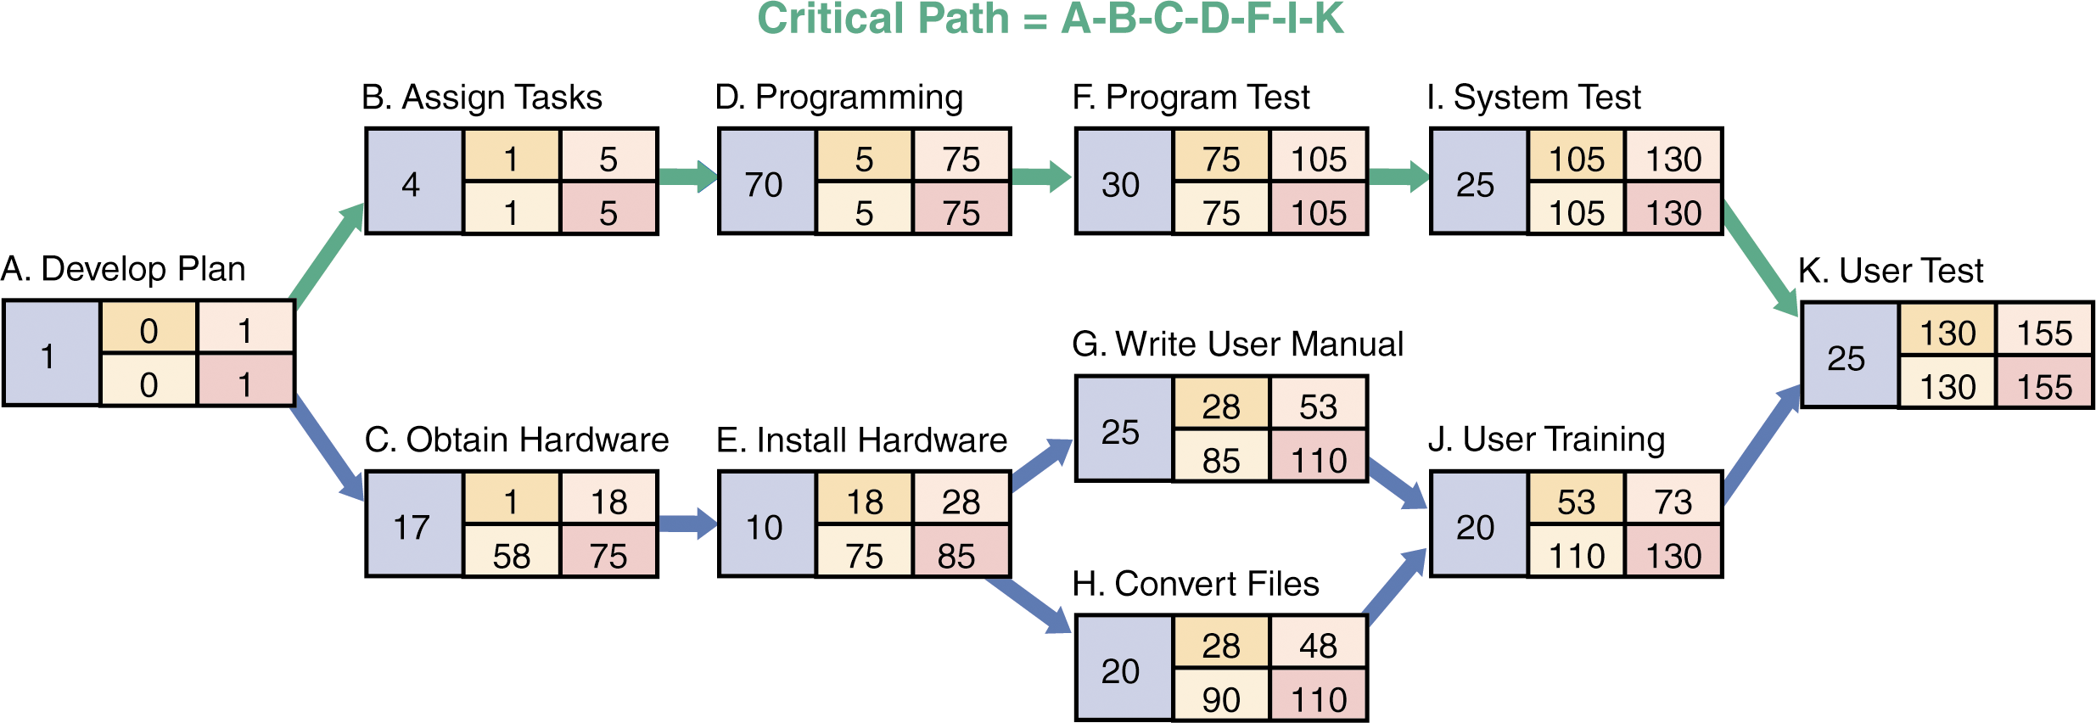
2. Project Planning – PERT Chart

Slide 20
2. Project Planning
Project scheduling involves separating the total work involved into separate activities and judging the time required to complete these activities
Project schedule is usually represented as a set of charts showing
work breakdown
activities dependencies and
staff allocations

Slide 21
2. Project Planning
Two commonly used graphically notations to represent project schedule are:
Gantt chart
PERT chart/ CPM chart
(Program Evaluation Review Technique / Critical Path Method)

Slide 22

3. PROJECT COSTING

Slide 23
3. Project Costing
Estimate Resources:
🡪hardware
🡪software
🡪people

Slide 24
3. Project Costing
Cost-Benefit Analysis Techniques:
Payback Period
Return on Investment (ROI)
Net Present Value (NPV)

Slide 25
3. Project Costing
Cost estimation – to estimate the resources required to accomplish the project plan:
hardware
software
people
Cost-benefit analysis techniques include :
Payback period
Return on Investment (ROI)
Net Present Value (NPV)

Slide 26

4. PROJECT MONITORING

Slide 27

4. Project Monitoring
Triple Constraints:
🡪 Time
🡪 Cost
🡪 Quality
Actual project progress
Planned project progress

Slide 28
4. Project Monitoring
Actual project progress
Planned project progress
Problems :
Behind schedule, over budget, unable to achieve the agreed quality attribute etc

Slide 29
4. Project Monitoring
Is a continuing project activity
Project manager must keep track of the project’s progress in terms of the time, cost and quality (triple constraints) 🡪 compare actual project progress with planned project progress
Problems : behind schedule, over budget, unable to achieve the agreed quality attribute etc.

Slide 30
4. Project Monitoring
Corrective actions
E.g. add more staff, reassign tasks, using OT, encourage staff etc
Formal vs informal reviews

Slide 31
4. Project Monitoring
Corrective actions need to be adopted depending on the situation.
E.g. add more staff, reassign tasks, using OT, encourage staff etc.
May include informal monitoring besides formal project reviews

Slide 32

5. PERSONAL SELECTION & MANAGEMENT

Slide 33

5. Personal Selection & Management
Application Domain
Adaptability
Programming Language Exp.
Right Candidate
Attitude
Communication Ability
Factors on staff selection

Slide 34
5. Personal Selection & Management
Ideally skilled staff with appropriate experience will be available to work on the project
Project manager should select the right candidates to join their project team.
Factors on staff selection include: application domain and prog. language experience, attitude, communication ability and adaptability.

Slide 35

5. Personal Selection & Management
Money
Leadership
Job Satisfaction
Thoughtful Job Design

Slide 36
5. Personal Selection & Management
People may be motivated by money, but they are motivated by other things as well – e.g. Job satisfaction.
Thoughtful job design can increase staff motivation
Different styles of leadership are needed in different situations

Slide 37
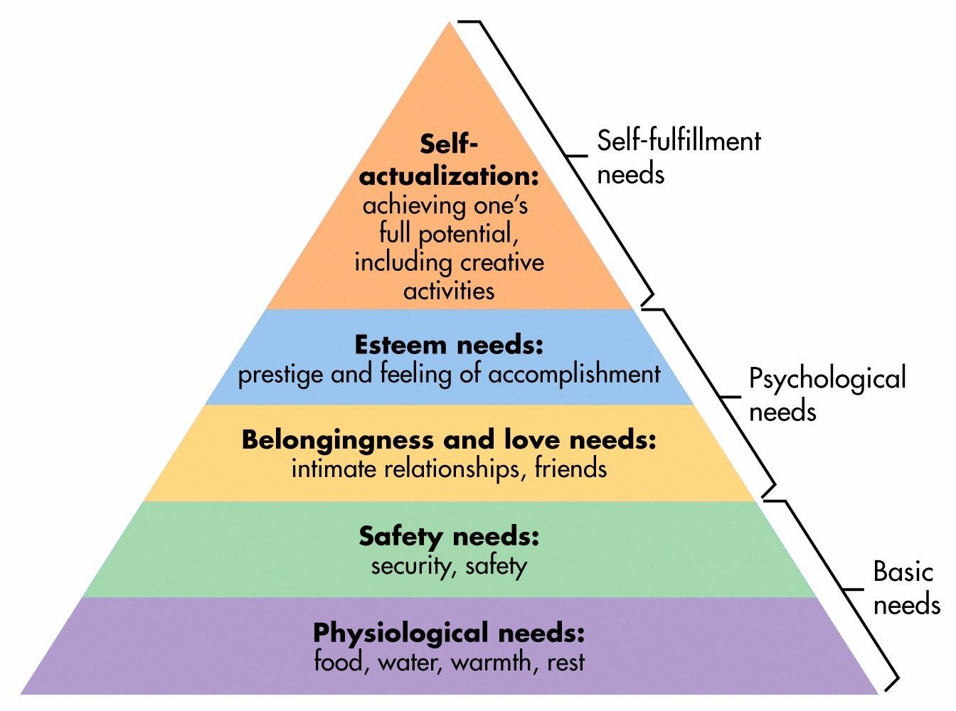
5. Personal Selection & Management: Maslow’s Motivation Model

Slide 38

5. Personal Selection & Management
Factors that influence Group Working

Slide 39

5. Personal Selection & Management
i. Group Composition
Is there the right balance skills, experience and personalities in the team?
Task-oriented
Factors that influence Group Working
Interaction-oriented
Self-oriented

Slide 40
5. Personal Selection & Management
ii. Group Cohesiveness
Does the group think of itself as a team rather than as a collection of individuals who are working together?
How to promote group cohesiveness?
Factors that influence Group Working

Slide 41
5. Personal Selection & Management
ii. Group Cohesiveness
How to promote group cohesiveness?
Establish group identity
Team building activities
Members are treated as responsible & trustworthy
Factors that influence Group Working

Slide 42

5. Personal Selection & Management
iii. Group Communication
Do the members of the group communicate effectively with each other?
Factors that influence Group Working
How to improve group communication?

Slide 43
5. Personal Selection & Management
iv. Group Organization
Is the team organized in such a way that everyone feels valued and is satisfied with their role in the group?
Factors that influence Group Working
Did you assign the right job to the right people?

Slide 44

6. REPORT WRITING AND PRESENTATION

Slide 45
6. Report Writing and Presentation
Reporting on the project
Document
Presentation

Slide 46
6. Report Writing and Presentation
Project managers are responsible for reporting on the project
They must write concise and coherent documents
Communication effectively both orally and in writing is an essential skill for a project manager.

Slide 47

Can good project management guarantee project success?
Good management cannot guarantee project success. However, bad management usually results in project failure. The software delivered late, costs more than originally estimated and fails to meet its requirements.

Slide 48
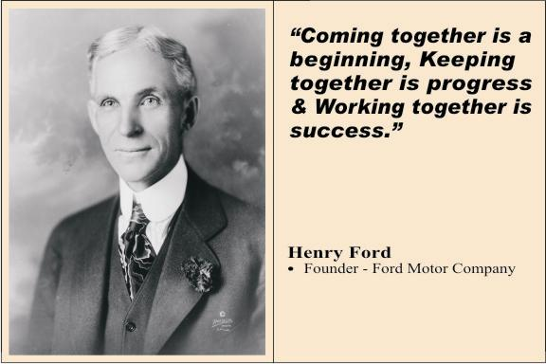

Slide 49
Exercise
Create a Gantt Chart based on the following information.
Activity | Duration (month) | Predecessor | Overlap
A | ½ | None | None
B | 1 | A | None
C | 2 | B | ¼
D | 1 | B | None
E | ½ | C, D | None

Slide 50
 |  | July |  |  |  | August |  |  |  | Sept |  |  |  | Oct
Task ID | Duration
A | 1/2
B | 1
C | 2
D | 1
E | 1/2
Assume the project starts in July

